Slide 1
Mapping the 2011 Census Burnage & Ladybarn
23 October 2013
Alison Peacock
Mission Planning Officer
Church & Society Department
Notes:
<number>

Slide 2
What can the 2011 Census tell us?
Who we are
How we live
What we do
A tool for understanding and engagement
Notes:
<number>

Slide 3
Presentation Overview
Age and Sex
Ethnic Groups
Religion
Household Composition & Tenure
Deprivation
Area Classification
Notes:
<number>

Slide 4
CENSUS DATA

Slide 5
NeSS Geography Hierarchy
Region
North West
Local Authority
Manchester
E08000003
Middle Super Output Area
Manchester 036
E02001080
Lower Super Output Area
Manchester
036A
E01005305
Output Area
E00026874
Notes:
<number>

Slide 6
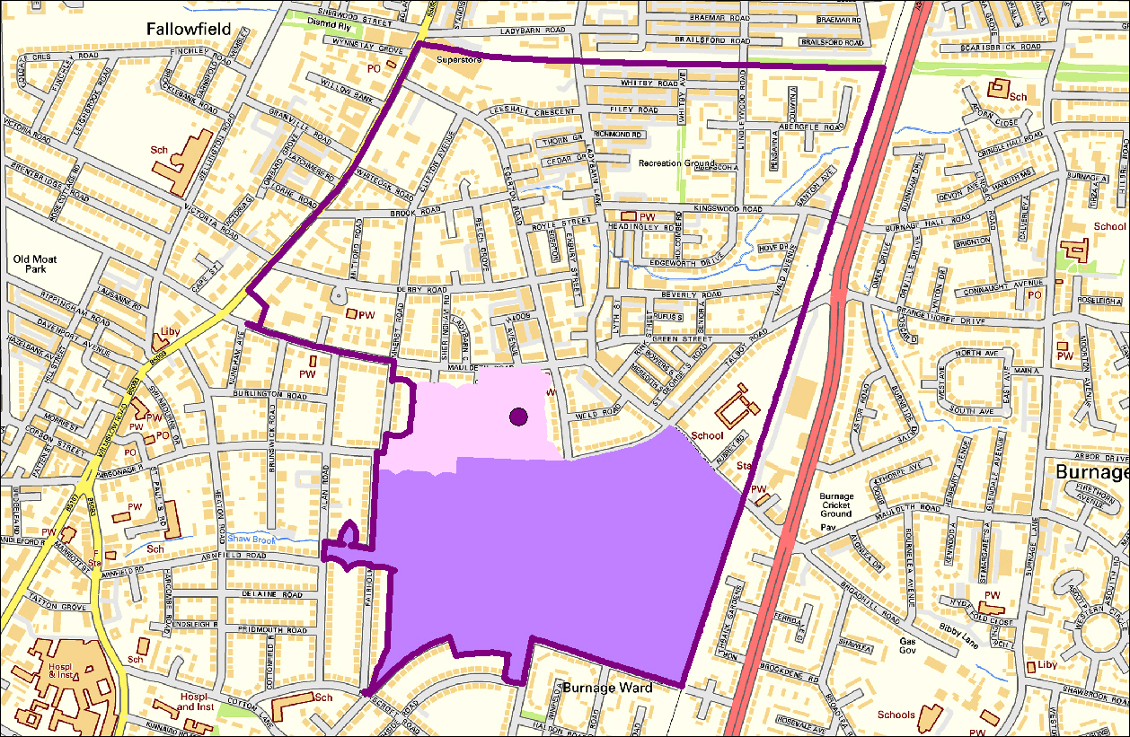
M20 4WH
Manchester 036
E02001080
E00026874
Manchester 036A
E01005305

Slide 7
Measuring Change
Population Base
Census Count (2001)
Quality Assured Population Estimates (2011)
Boundary Changes
Parish
Neighbourhood Geographies

Slide 8
Age & SEX
Notes:
<number>

Slide 9
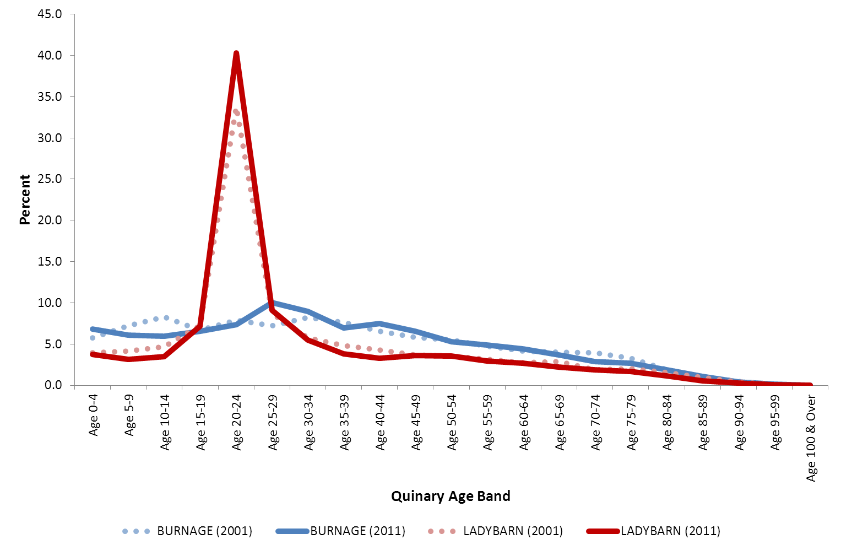
Burnage & Ladybarn by Age (2001-11)

Slide 10
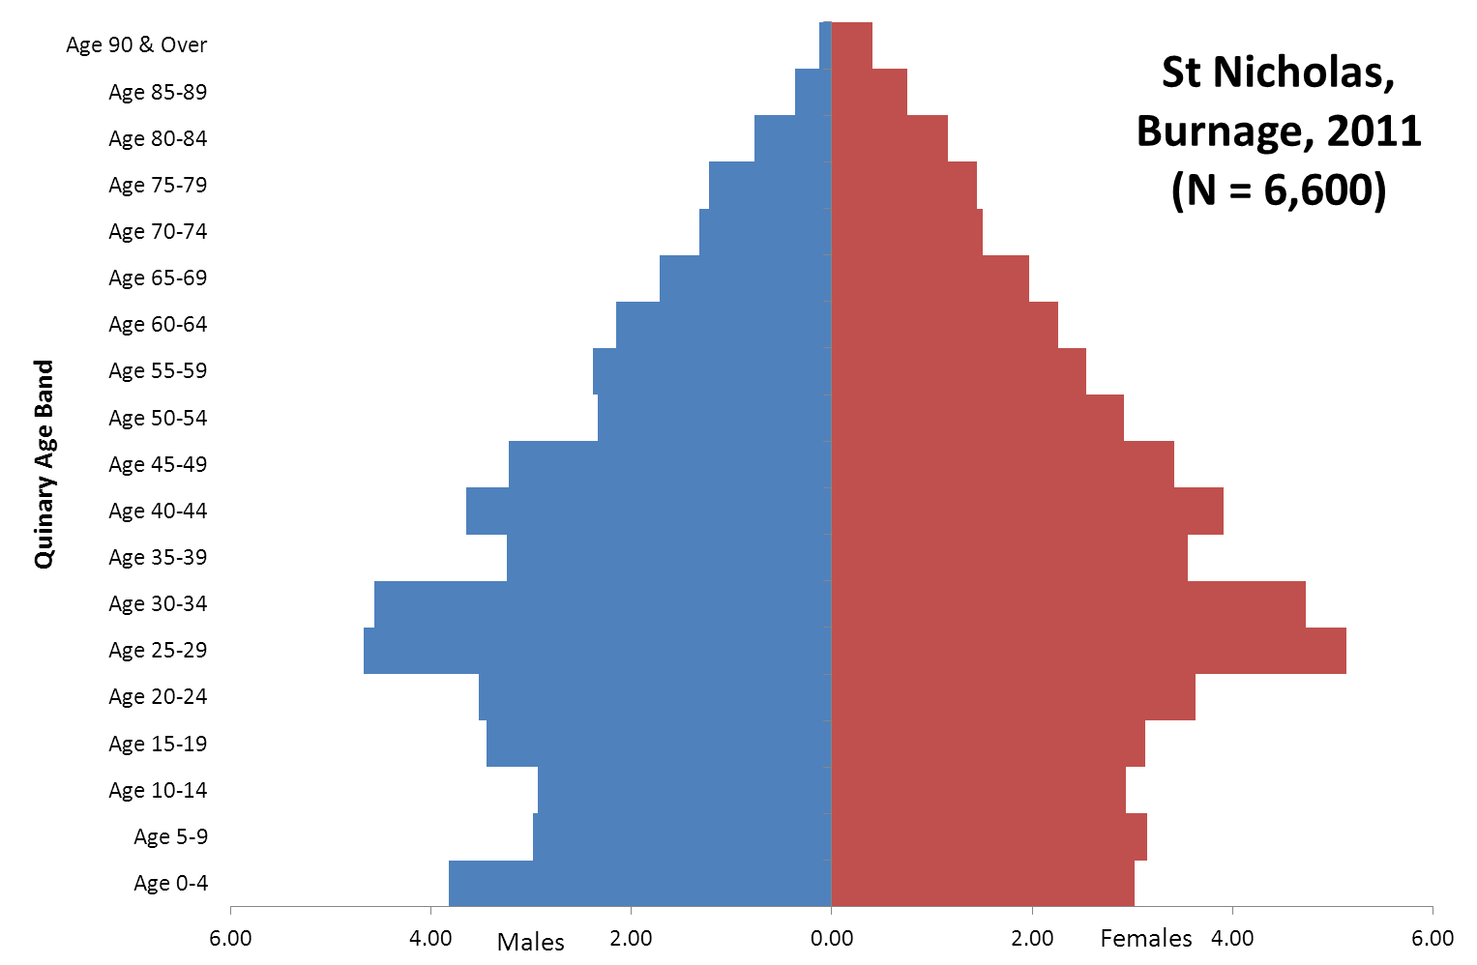

Slide 11
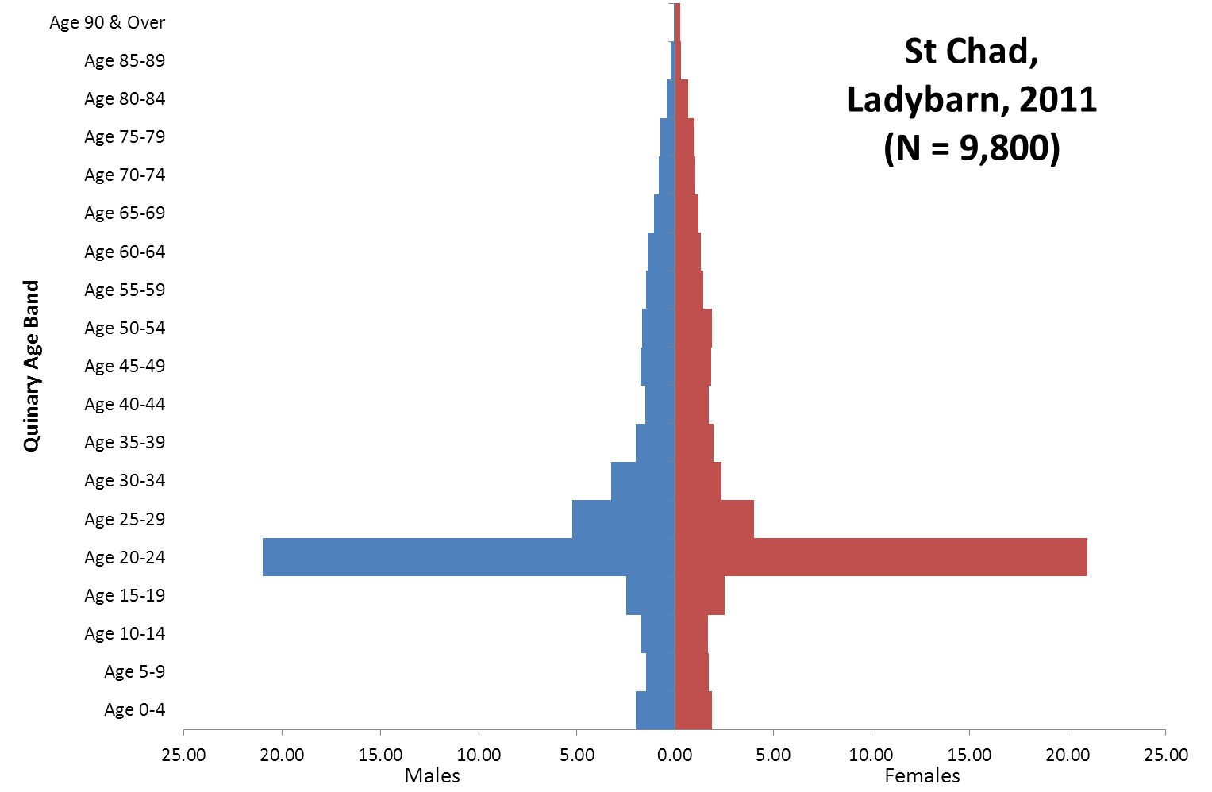

Slide 12
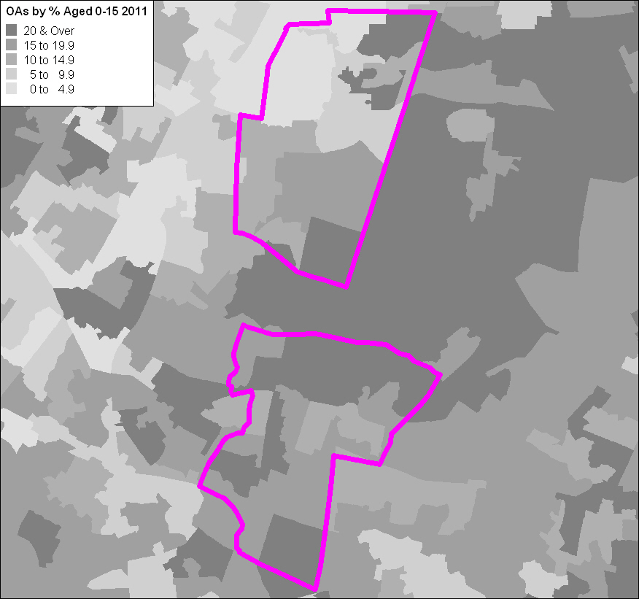
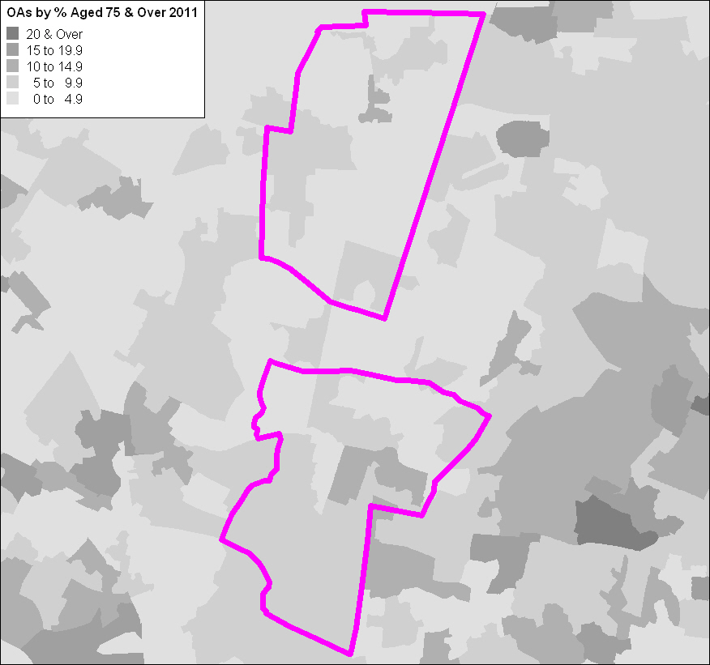
Burnage & Ladybarn by Children & Older People (2011)
Aged 0-15
Aged 75 & Over
Notes:
<number>

Slide 13
ETHNIC GROUPS
Notes:
<number>

Slide 14
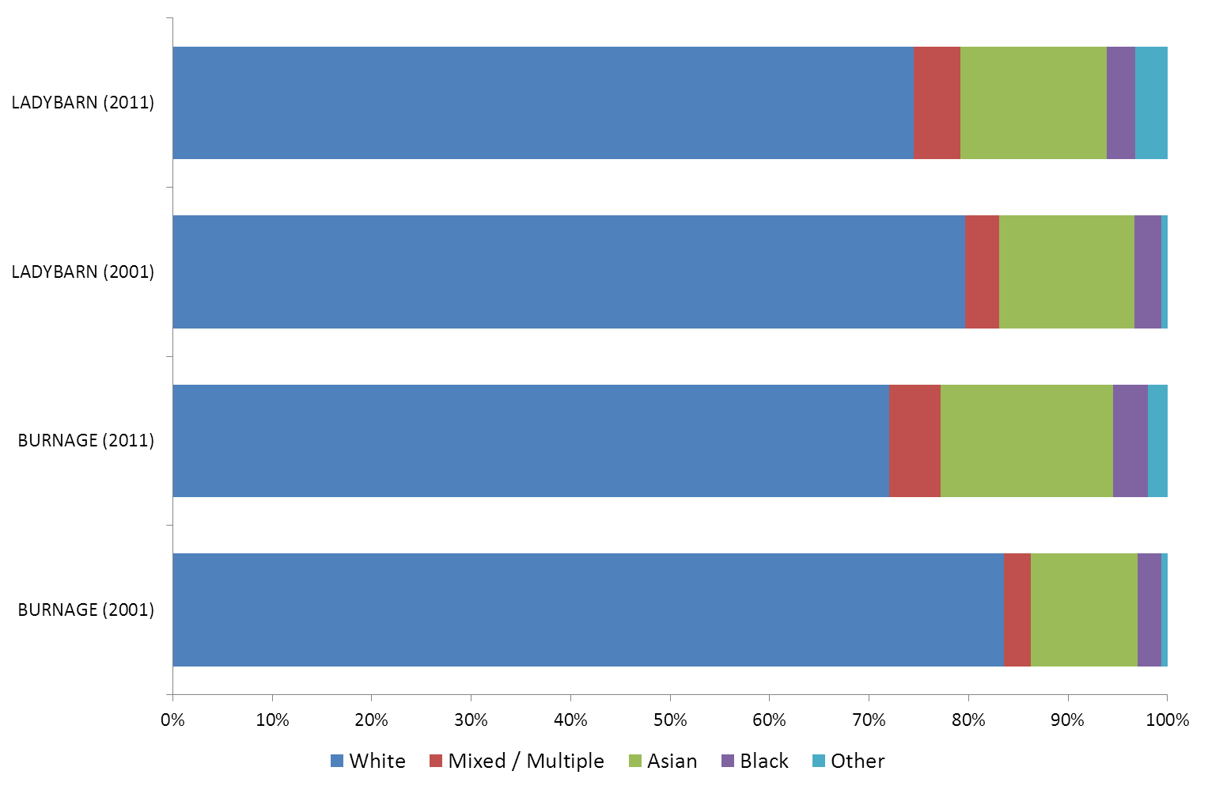
Burnage & Ladybarn by Broad Ethnic Group (2001-11)

Slide 15
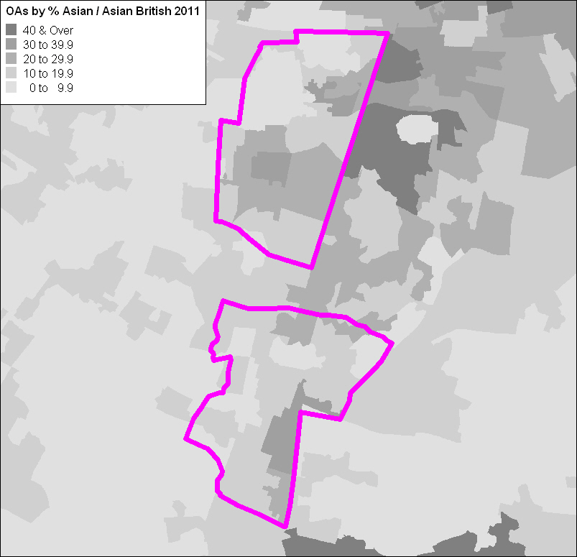
Burnage & Ladybarn Asian (2011)
Burnage
10.8% (2001)
17.3% (2011)
Ladybarn
13.6% (2001)
14.7% (2011)
Notes:
<number>

Slide 16
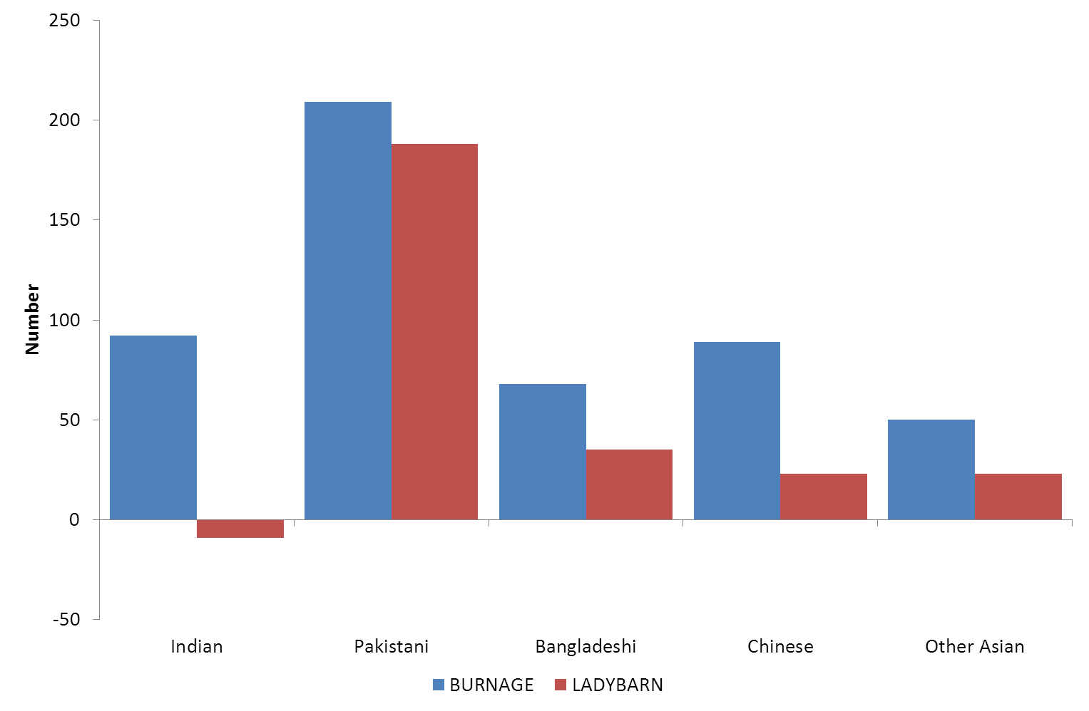
Burnage & Ladybarn by Asian / Asian British (2001-11)

Slide 17
“Other White” & East European (2011)
 | “Other White”
 | Count | Percent
Burnage | 206 | 3.1
Ladybarn | 392 | 4.0
Born in EU 2004 Accession Country
Burnage (68)
Ladybarn (173)
Born in Poland
Burnage (36)
Ladybarn (68)

Slide 18
RELIGION
Notes:
<number>

Slide 19
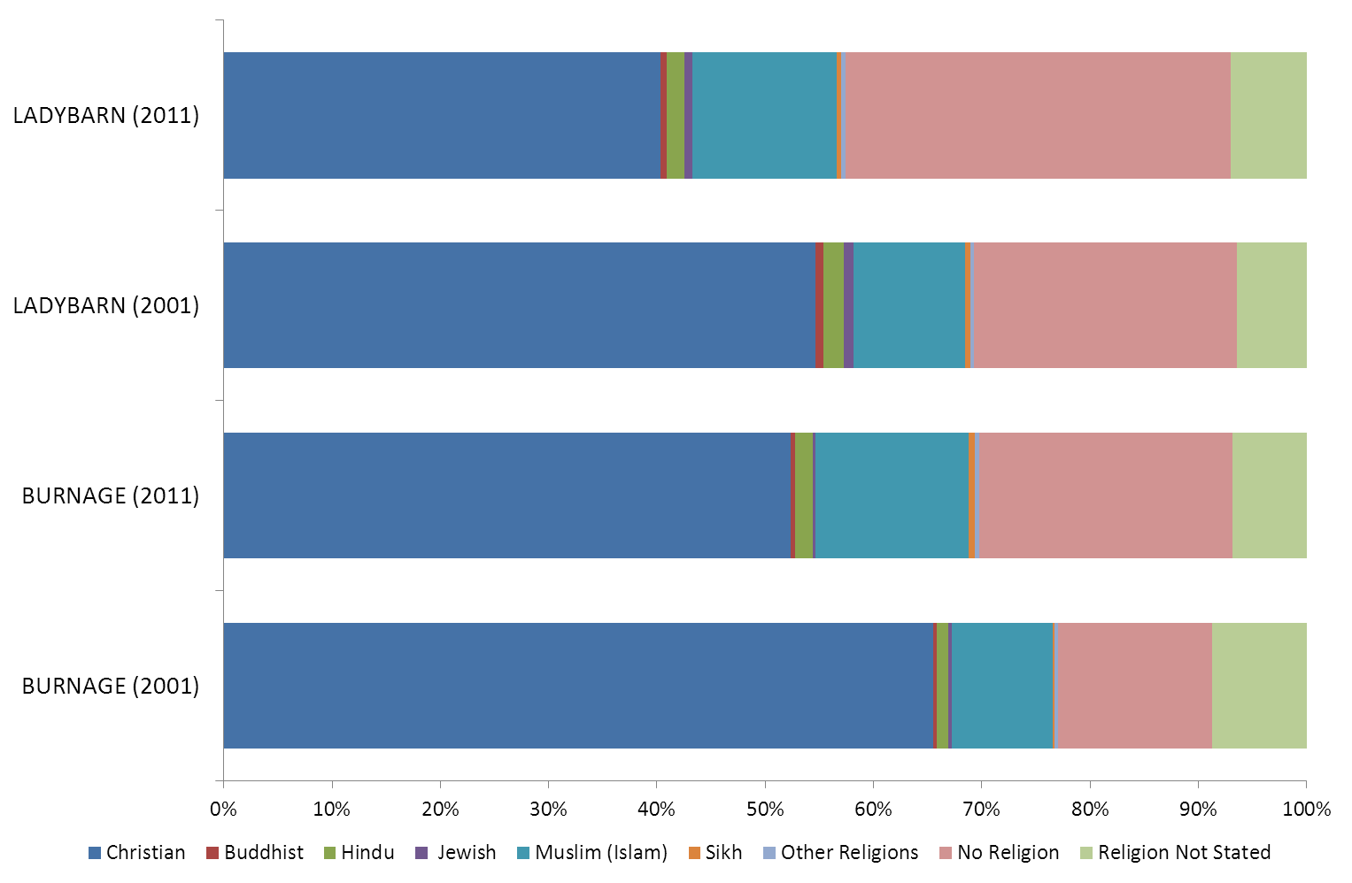
Burnage & Ladybarn by Religion (2001-11)

Slide 20
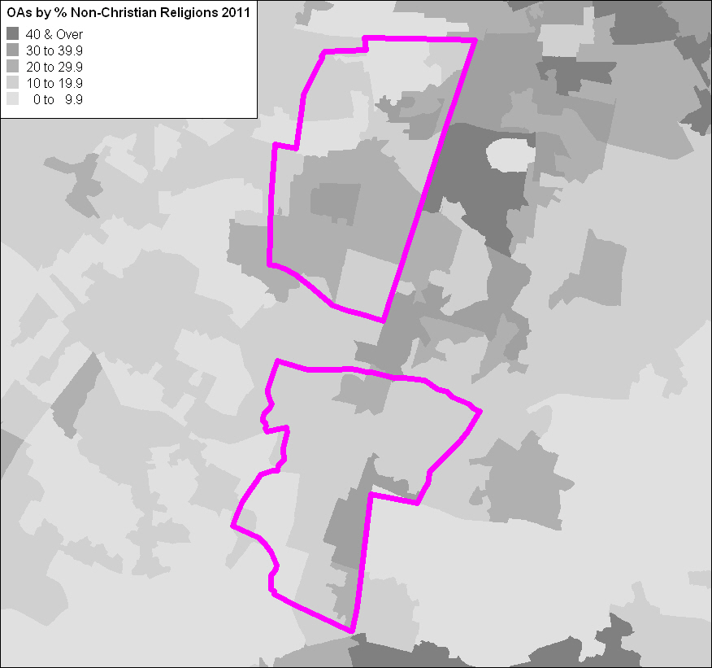
Burnage & Ladybarn Non-Christian Religions (2011)
Burnage
11.5% (2001)
17.4% (2011)
Ladybarn
14.7% (2001)
17.0% (2011)

Slide 21
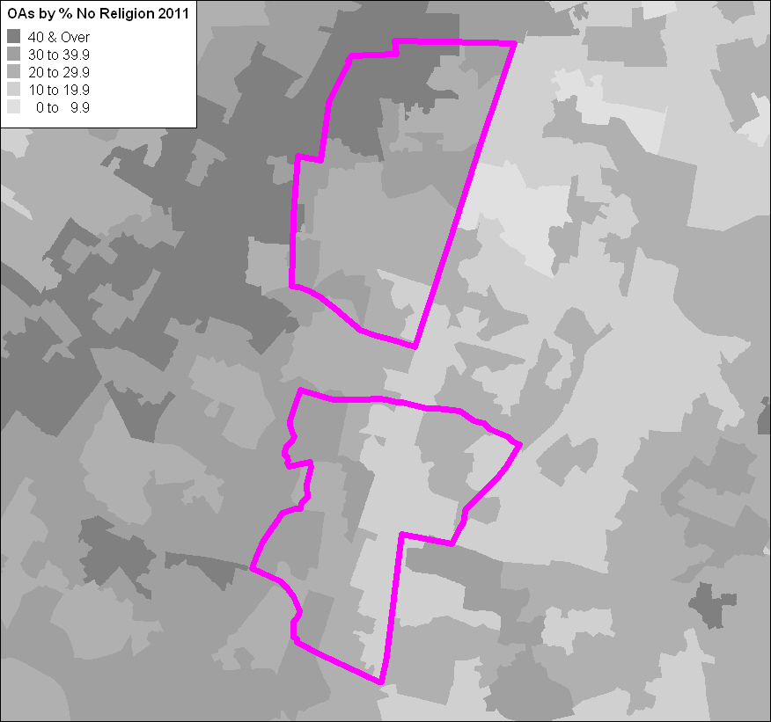
Burnage & Ladybarn No Religion (2011)
Burnage
14.2% (2001)
23.4% (2011)
Ladybarn
24.3% (2001)
35.6% (2011)

Slide 22
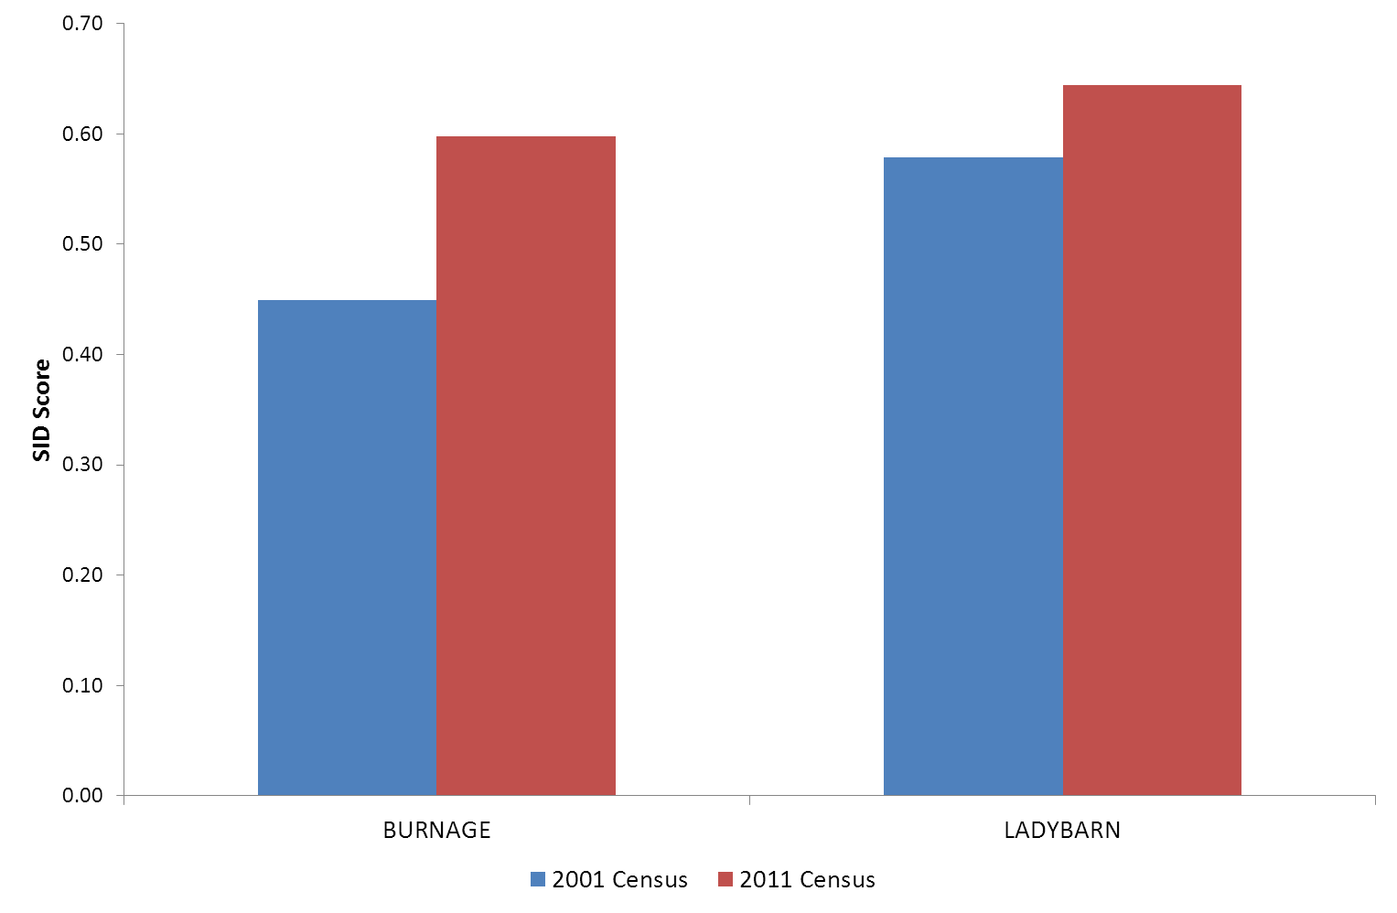
Burnage & Ladybarn Religion by Simpson’s Index of Diversity (2001-11)

Slide 23
HOUSEHOLDS

Slide 24
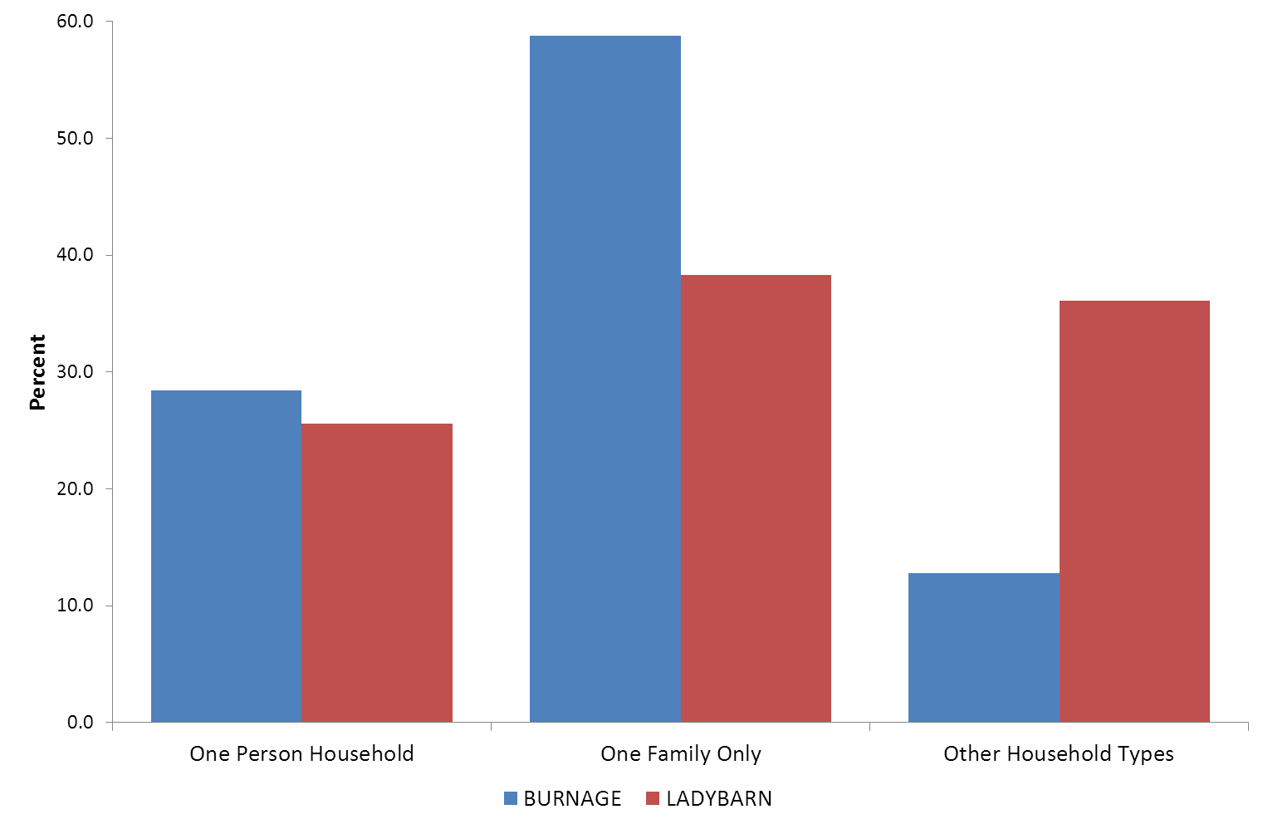
Burnage & Ladybarn Household Composition (2011)

Slide 25
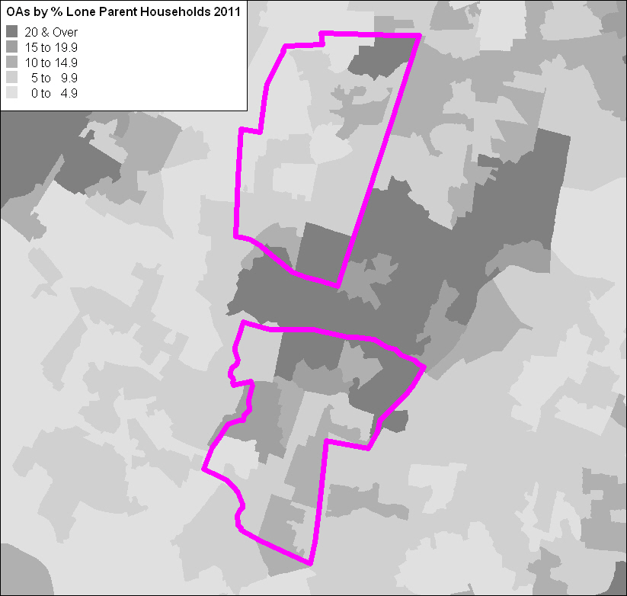
Burnage & Ladybarn Lone Parent Households (2011)
Burnage (14.5%)
Dependent children (9.1%)
All children non-dependent (5.4%)
Ladybarn (9.2%)
Dependent children (5.7%)
All children non-dependent (3.6%)
Notes:
<number>

Slide 26
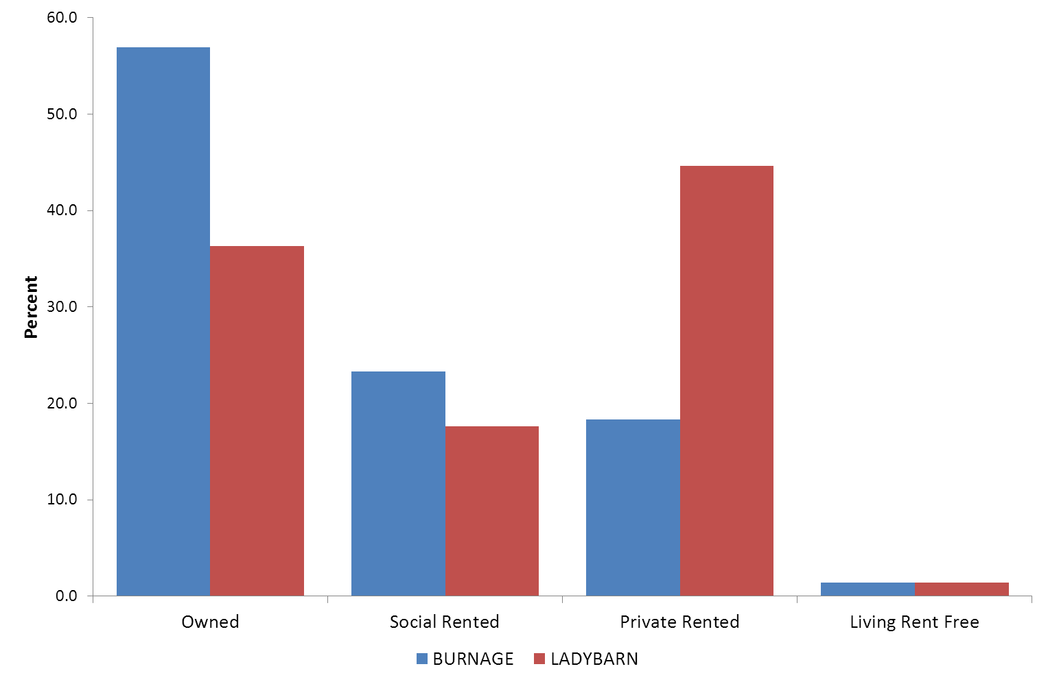
Burnage & Ladybarn by Household Tenure (2011)

Slide 27
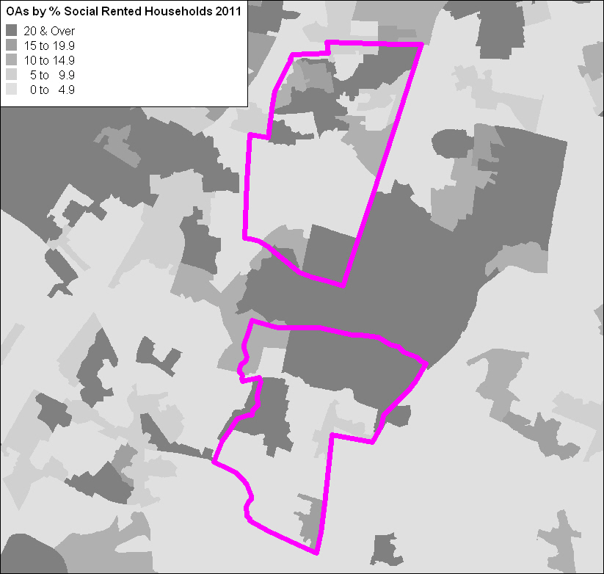
Burnage & Ladybarn Social-Rented (2011)
Burnage (23.5%)
Council (9.1%)
Other (14.2%)
Ladybarn (17.6%)
Council (5.6%)
Other (12.1%)

Slide 28
DEPRIVATION
Notes:
<number>

Slide 29
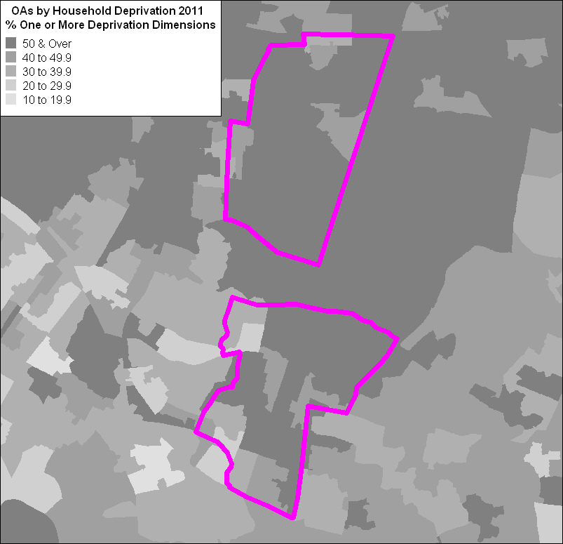
Burnage & Ladybarn Household Deprivation Dimensions (2011)
Unemployment
Unemployed or long-term sick
Education
Low level education and no person aged 16-18 a full-time students
Health & Disability
“Bad” or “very bad” general health or long-term health problem
Housing
Overcrowded, in shared dwelling or no central heating

Slide 30
Burnage & Ladybarn by Household Deprivation Dimensions (2011)
% Households | Burnage ( N = 2,690) | Ladybarn (N = 3,270)
Not deprived in any dimension | 42.3 | 44.0
Deprived in 1 dimension | 30.8 | 31.7
Deprived in 2 dimensions | 19.9 | 17.4
Deprived in 3 dimensions | 6.4 | 6.2
Deprived in 4 dimensions | 0.6 | 0.6

Slide 31
Census-based Deprivation Indices
Most widely used Government measure of neighbourhood deprivation is not census-based
Indices of Deprivation 2010
Census has been used as basis of two widely used deprivation indices since 1981
Townsend Index
Carstairs Index
Both re-created for small area geographies in 2011
available for revised boundaries
Notes:
<number>

Slide 32
Census Deprivation Indicators
Townsend Index | Carstairs Index
% Unemployed | % Males unemployed
% Households with no access to a car | % Households with no access to a car
% Households with > 1.5 persons per room | % Households with > 1.5 persons per room
% Non-home ownership | % Persons in semi- and routine occupations
Notes:
<number>

Slide 33
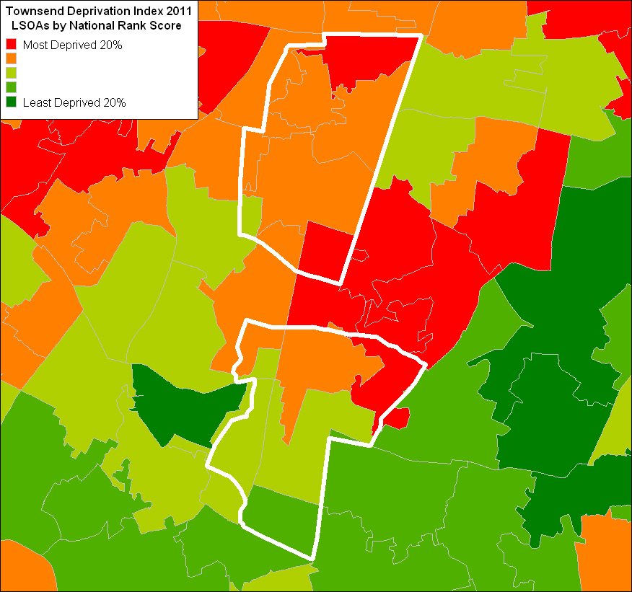
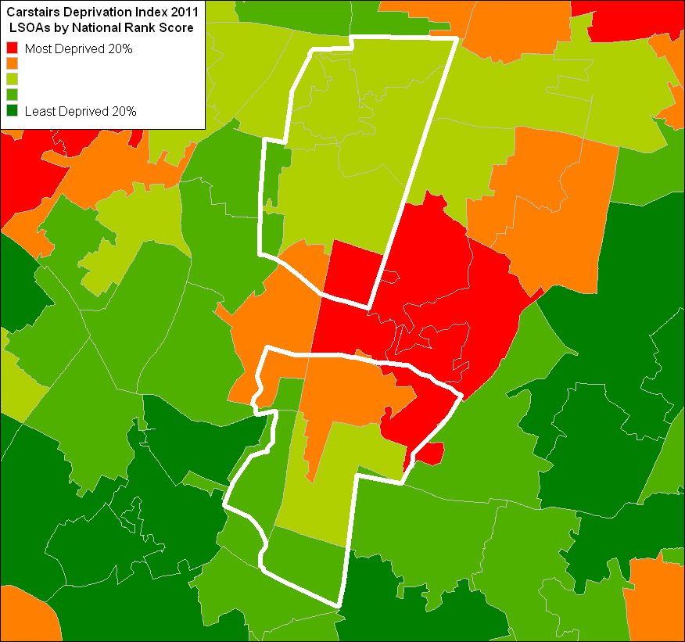
Burnage & Ladybarn By 2011 Census Deprivation Indices
Townsend
Carstairs

Slide 34
AREA CLASSIFICATION

Slide 35
2011 Output Area Classification England & Wales (Preliminary)
Based on 62 variables from the 2011 Census
Clustered to form a 3 tier classification
8 Supergroups
24 Groups
67 Subgroups
Use to compare areas

Slide 36
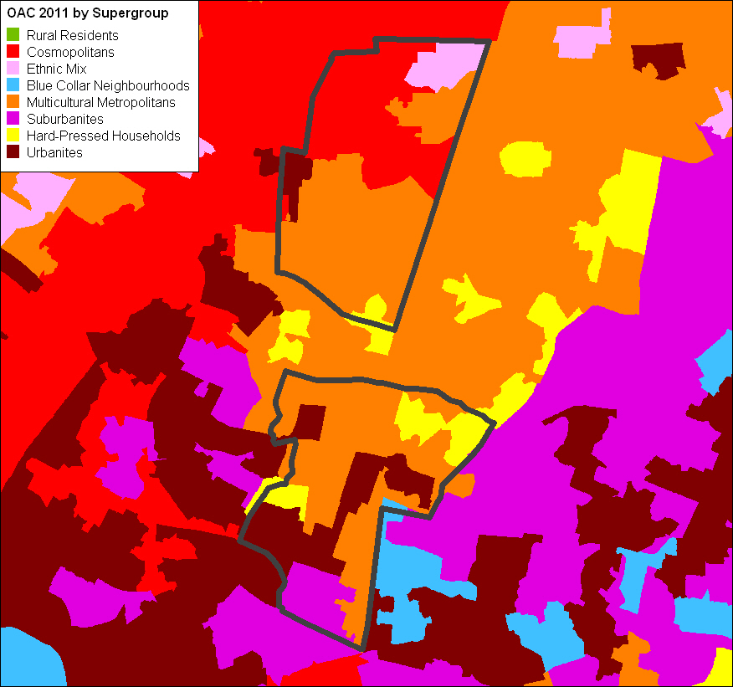
Burnage & Ladybarn by OAC Supergroup
Rural Residents
Cosmopolitans
Ethnic Mix
Blue Collar Neighbourhoods
Multicultural Metropolitans
Suburbanites
Hard-pressed Households
Urbanites
Notes:
<number>

Slide 37
Cosmopolitans
The majority of the population in this group live in densely populated urban areas.
Likely to live in flats that are privately rented with a below average number of rooms. There is more chance they will have access to a second address elsewhere (non-term time addresses for students).
High ethnic integration, with an above average number of residents from EU accession countries coinciding with a below average number of UK and Irish residents.
Likely to have higher-level qualifications than the national average and be in above average health.
Primarily young adults that are likely to be single and not have children. They are likely to be either full-time students living away from home or working in service industries.
Likely to use public transport, walk or cycle to get to work.
Notes:
<number>

Slide 38
Multicultural Metropolitans
Concentrated in larger urban conurbations in the transitional areas between urban centres and suburbia.
Likely to live in terraced housing that is rented – both private and social.
High ethnic mix, but a below average number of UK and Irish residents.
Likely to be below retirement age with an above average number of families with pre-school or school-age children.
The level of qualifications is just under the national average with the rates of unemployment being slightly above the national average.
Residents who are employed are more likely to work in the transport, storage or the hospitality sectors.
Public transport is the most likely method for individuals to get to and from work.

Slide 39
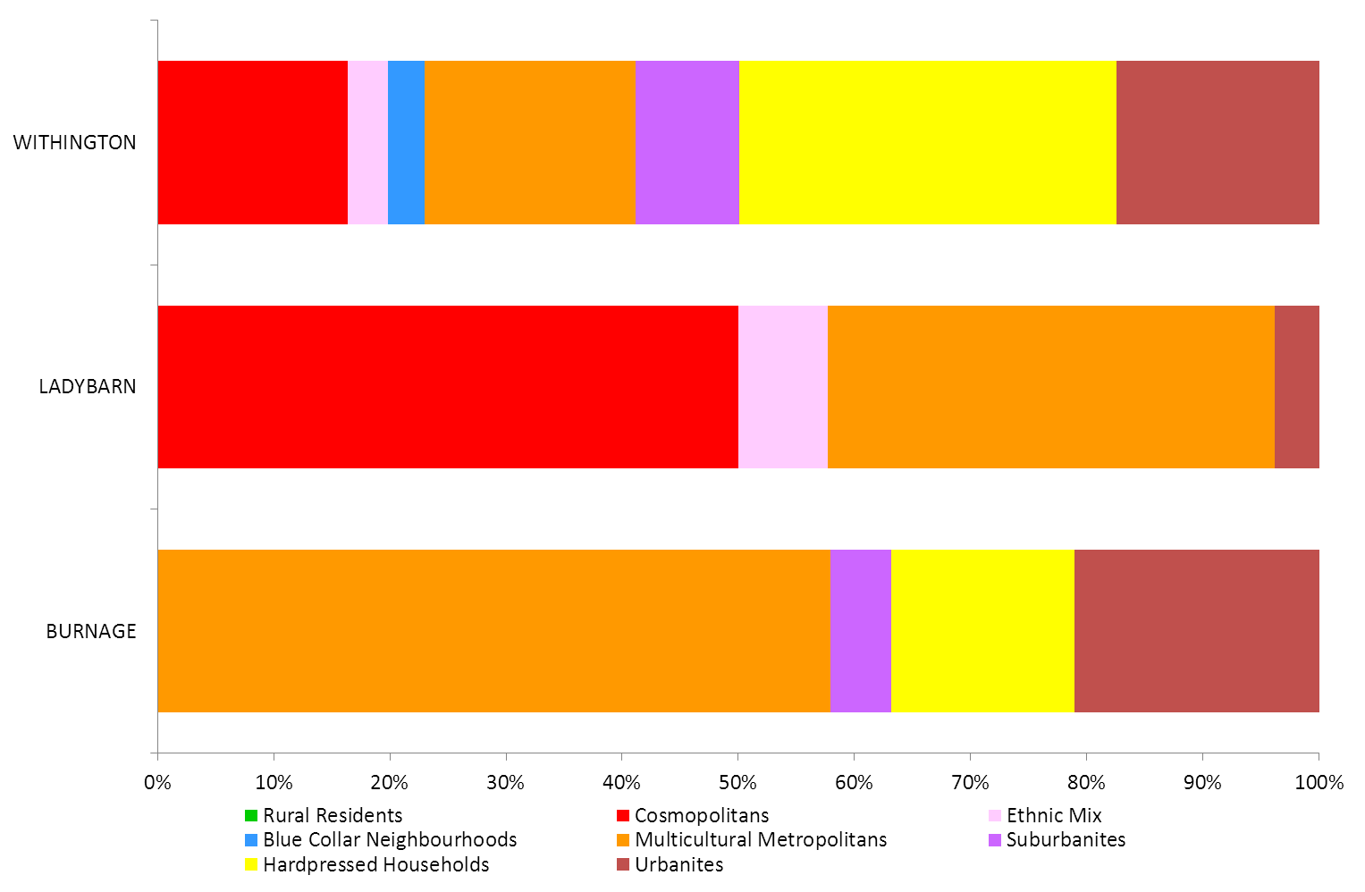
Burnage & Ladybarn by OAC 2011 Supergroup
Notes:
<number>

Slide 40
Contact Details
Alison Peacock
Mission Planning Officer
Church & Society Department
apeacock@manchester.anglican.org
0161-828 1447 (direct)
Notes:
<number>

